Slide 1
UM Product Features

Slide 2
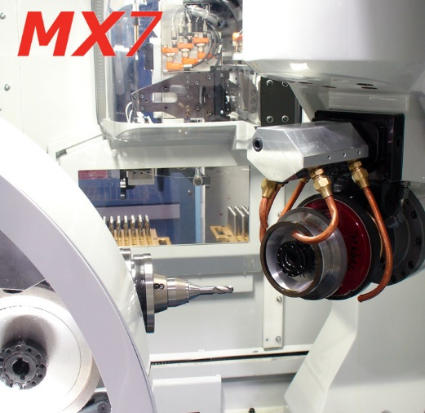
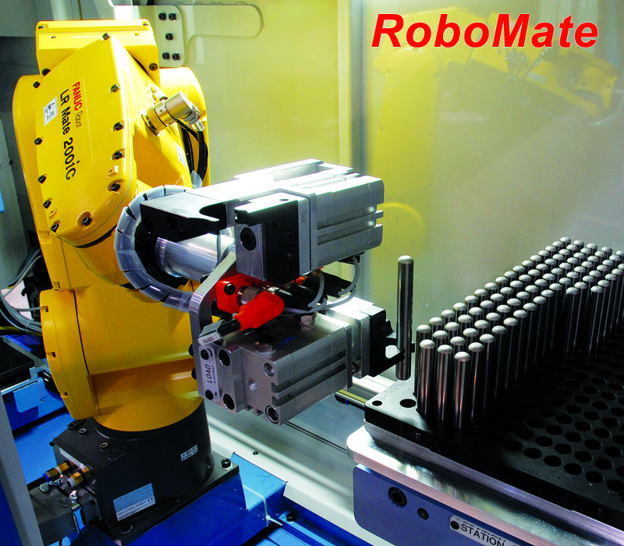
1. Robot Equipment & Auto Supply & Introduction simulator

Slide 3
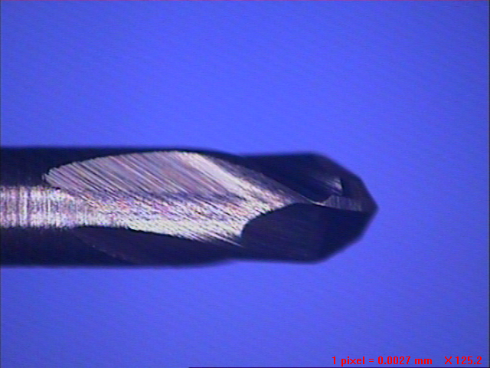
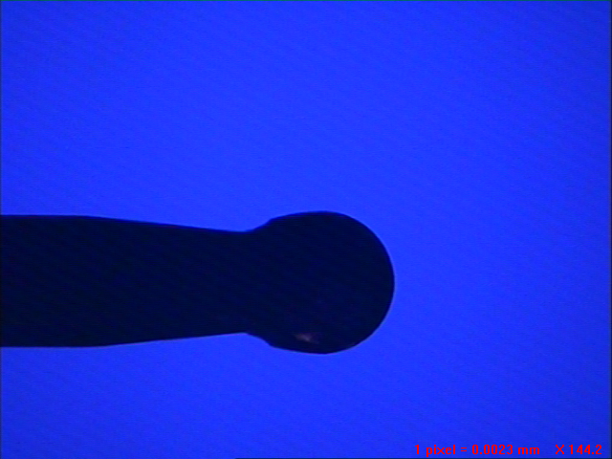
2. Small diameter ball end mill geometry
R0.2 Ball Endmill
R0.2 Ball Endmill A projection pictures

Slide 4
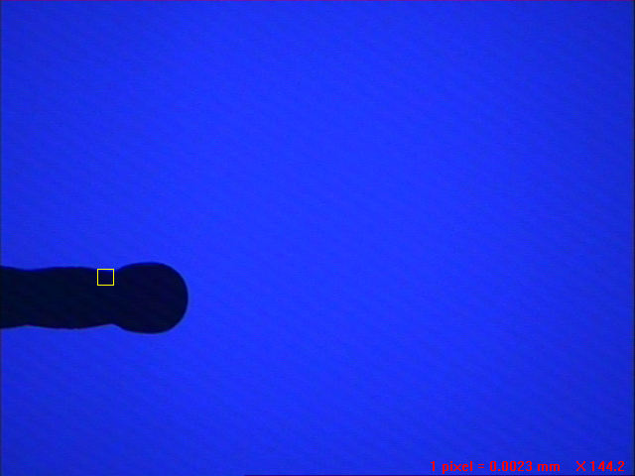
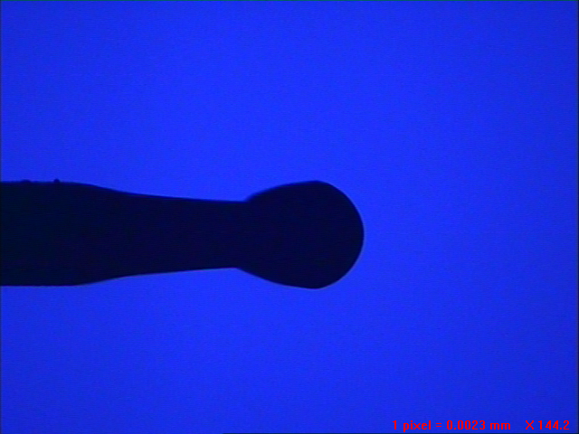
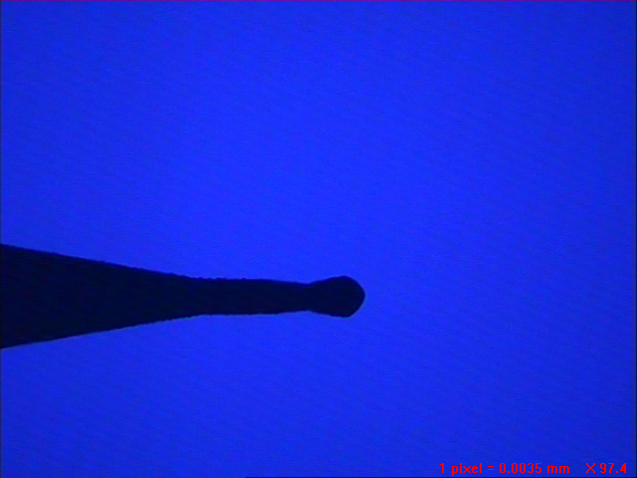
5. Small diameter Ball projected pictures
UM R0.15 A projection pictures
UM R0.1 A projection pictures
A社 R0.15 A projection pictures
B社 R0.1 A projection pictures

Slide 5
7. BALL cutting angle is continuously variable (3 cutting angle change point)
Less cutting resistance design - realize superior machined surfaces (walls)
BALL center-designed to increase the strength of the front end portion (z-axis)

Slide 6
8. Osaka, Japan Industrial Technology Research Institute compared to other products tested data processing
When evaluating the abrasion and cut resistance, such as day rankings UM HMB230 R3 is also rated as best

Slide 7
Car Headlights -1 6Ball RPM 18,000 Processing (front-finishing) / Processing Equipment MICRON 800LP Coolant : Oil-Mist Work material : CENA-G

Slide 8
Car Headlights 2 6Ball RPM 18,000 Processing (front-finishing) /Processing Equipment MICRON 800LP

Slide 9
Car Headlights -3 0.4Ball RPM38,000 (Pattern parts) / Processing Equipment MICRON 800LP

Slide 10
Car Headlights -4 0.6Ball RPM34,000 (Pattern parts) / Processing Equipment MICRON 800LP

Slide 11
Car Headlights -5 6Ball RPM 18,000 front-finishing/ Processing Equipment MICRON 800LP

Slide 12
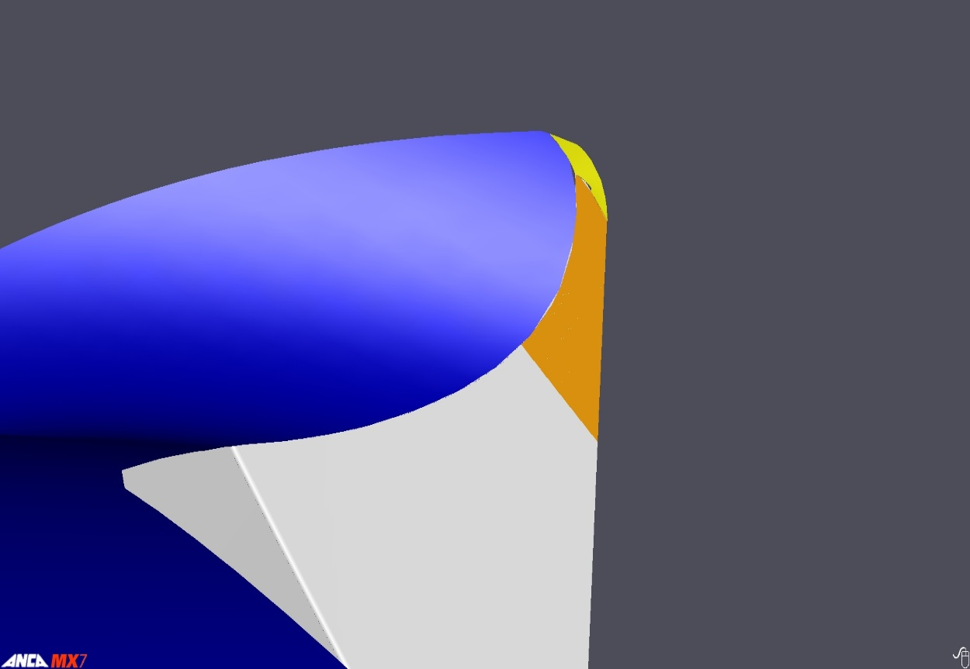
9. Excellent product performance and design of the corner radius
Three-dimensional design of the corner R-
R increases strength and prevents chipping

Slide 13
10. Compare the corner radius machining data

Slide 14
UM product sectors and companies
■Injection mold
Electronics (TV, mobile phones, semiconductors)
The optical module (optical lens, LED, etc.)
Precision Mold (Mobile Camera barrel, Connector, etc.)
Cars (lamps, electric parts)
■Press Mold
Electron

Slide 15
감사 합니다.

